Slide 1
how using dither impacts the MSE

Slide 2
agenda
we have a given quantizers and we want to check if adding uniform dist, quantize and then subtracted the uniform will give better performance than only quantizing without dither.
the bottom line is that it’s better with dither but only at bin size at the quantization that we don’t work with
by what I see, it seems to help only because the big quantization is away from the data dist and the dither just through it back to the data dist, with no connection of what it was on the data dist

Slide 3
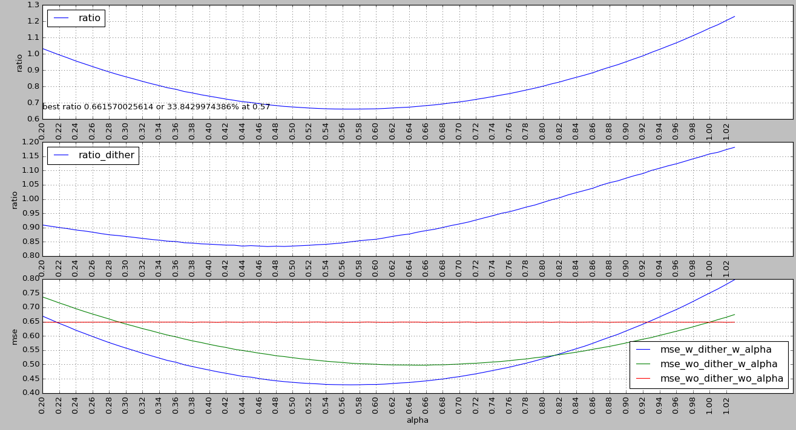
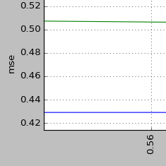
bin size = 3 (without modulo)
at this alpha (0.57) we will get our best mse
ratio between w alpha w dither and wo alpha wo dither
ratio between w alpha w dither and w alpha wo dither
zoom in…

Slide 4
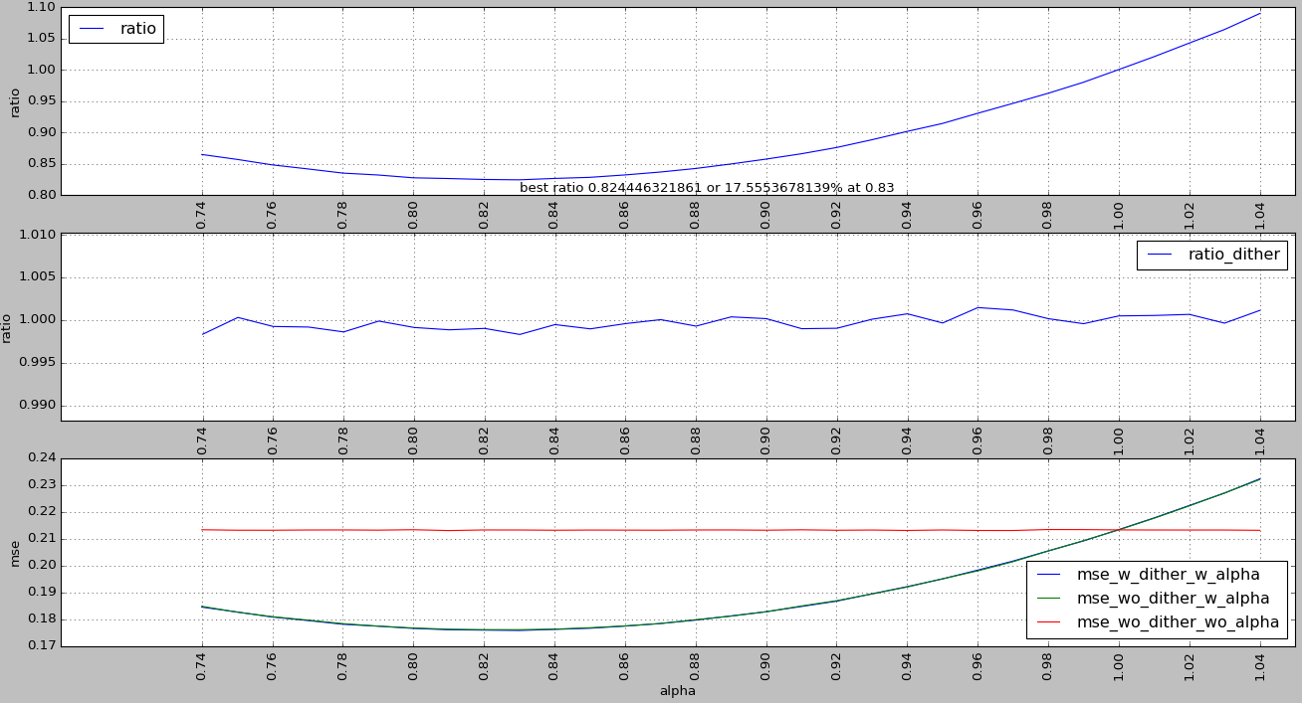
bin size = 1.6
1.6 is the bin size for 3 quants. so this is our worst case…
we can see that the ratio is very close to 1
hard to say the different between them…

Slide 5
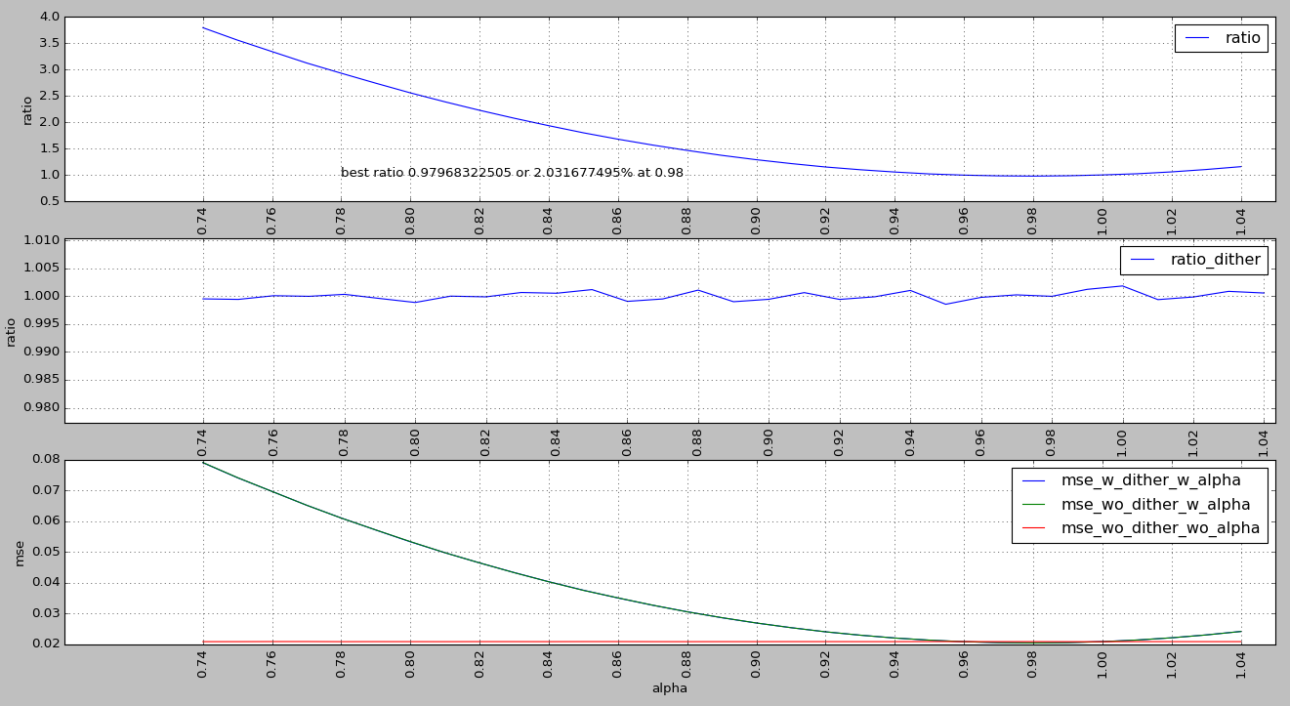
bin size = 0.5

Slide 6
best bin sizes per number of quantizer for data var = 1 (with modulo)
3: 1.6400000000000015,
4: 1.342000000000001,
5: 1.1866666666666676,
6: 1.0021428571428579,
7: 0.91375000000000073,
8: 0.83888888888888946,
9: 0.75650000000000084,
10: 0.66045454545454607,
11: 0.63333333333333375,
12: 0.57346153846153891,
13: 0.53500000000000059,
14: 0.51066666666666682,
15: 0.48218750000000021,
16: 0.4529411764705884,
17: 0.43416666666666703,
18: 0.41526315789473722,
19: 0.38925000000000054,
20: 0.36142857142857165,
21: 0.36818181818181861,
22: 0.34456521739130475,
23: 0.3266666666666671,
24: 0.31840000000000046,
25: 0.30692307692307708,
26: 0.28555555555555578,
27: 0.28392857142857153,
28: 0.27741379310344838,
29: 0.26583333333333359,
30: 0.25983870967741973,
31: 0.24562500000000043,
32: 0.2360606060606063,
33: 0.23573529411764715,
34: 0.21785714285714297,
35: 0.22208333333333341,
36: 0.21310810810810832,
37: 0.21381578947368451,
38: 0.20243589743589752,
39: 0.18800000000000017

Slide 7
python code
from numpy import *
import pandas as pd
import pylab
set_printoptions(precision=5)
min_alpha=0.74
min_alpha=0.2
max_alpha=1.04
##max_alpha=2
samples=4e6
samples=2e4
bin_size=1.6
##bin_size=0.5
##bin_size=3
class pc():
def __iter__(self):
return self.__dict__.iteritems()
def table(self):
data=pd.DataFrame([{k:v for k,v in dict(self).iteritems() if self.t(v)}])
#return data
return data.transpose()
def t(self,v):
try:
return size(v)<10
except:
return False
def qnt(bin_size,numbers):
ret=bin_size*rint(numbers/bin_size)
return ret
def calc_mse(est,real):
e=est-real
return e*e.T/e.size
class fl(pc):
def __init__(self,alpha):
self.alpha=alpha
self.s=samples
## self.s=1.0
self.bin_size=bin_size
self.var_x=1.0
self.x=mat(random.normal(0,sqrt(self.var_x),self.s))
self.u=mat(random.uniform(-self.bin_size/2,self.bin_size/2,self.s))
## self.u=0
self.x_qnt_without_dither=qnt(self.bin_size,self.x)
self.x_with_u=self.x+self.u
self.x_qnt_with_dither=qnt(self.bin_size,self.x_with_u)-self.u
self.mse_wo_dither_wo_alpha=calc_mse(self.x_qnt_without_dither,self.x)
self.mse_wo_dither_w_alpha=calc_mse(self.x_qnt_without_dither*self.alpha,self.x)
self.mse_w_dither_w_alpha=calc_mse(self.x_qnt_with_dither*self.alpha,self.x)
self.ratio=self.mse_w_dither_w_alpha/self.mse_wo_dither_wo_alpha
self.ratio_dither=self.mse_w_dither_w_alpha/self.mse_wo_dither_w_alpha
#run sim:
d=pd.concat([fl(i).table() for i in arange(min_alpha,max_alpha,0.01)],axis=1).transpose().reset_index()
#results:
def on_subplot():
pylab.xlabel('alpha')
pylab.grid()
pylab.legend(loc="best")
pylab.xticks(arange(min_alpha,max_alpha,0.02),rotation=90)
pylab.title("bin size = "+str(bin_size))
pylab.subplot(3,1,1)
pylab.plot(d["alpha"],d["ratio"],label="ratio")
min_ratio=d.iloc[d['ratio'].idxmin()]
pylab.text(min_alpha,min_ratio['ratio'],"best ratio "+str(min_ratio['ratio'].A1[0])+" or "+str((1-min_ratio['ratio'].A1[0])*100.0)+"% at "+str(min_ratio['alpha']))
on_subplot()
pylab.ylabel('ratio')
pylab.subplot(3,1,2)
pylab.plot(d["alpha"],d["ratio_dither"],label="ratio_dither")
on_subplot()
pylab.ylabel('ratio')
pylab.subplot(3,1,3)
pylab.plot(d["alpha"],d["mse_w_dither_w_alpha"],label="mse_w_dither_w_alpha")
pylab.plot(d["alpha"],d["mse_wo_dither_w_alpha"],label="mse_wo_dither_w_alpha")
pylab.plot(d["alpha"],d["mse_wo_dither_wo_alpha"],label="mse_wo_dither_wo_alpha")
on_subplot()
pylab.ylabel('mse')
pylab.show()

